Slide 1

Churn at Fit.ly Tech
Data Analyst Professional Practical Exam Submission - DataCamp

Slide 2

Project Overview
This analysis investigates the upward trend in customer churn at Fit.ly Tech over the last two quarters. By synthesizing account data, support interactions, and user behavior metrics to identify key indicators associated with churn to inform retention strategies. These findings highlight correlations and behavioral patterns, not direct causal links.
1
2
Data Validation
Exploratory Analysis
Cleaning steps for every column.
Graphics showing single and multiple variables.
3
4
Metric Definition
Recommendations
A new metric for business monitoring.
Strategic actions for the business.

Slide 3
Data Validation & Cleaning
The dataset required significant cleaning and validation across three sources: Account Info, Customer Support, and User Activity. Below are the key steps taken for each column.
event_type: Missing values filled with 'no_activity’.
channel: Inconsistent chars replaced, missing values 'no_ticket’.
topic: Validated categories, nulls filled with 'no_ticket’.
ticket_time: Converted to Datetime.
ticket_status: Validated numeric code, renamed from 'state’.
resolution_time_hours: Calculated, handled outliers.
churn_status: Target variable, standardized 'Yes'/'No’.
comments: Manually inspected for GDPR deletion requests, records dropped.
customer_id: Removed 'C' prefix, converted to integer.
user_id: Key for merging, dropped post-merge.
state: Validated geographic consistency.
email: Checked for duplicates.
plan: Standardized to 'Free', 'Basic', 'Pro', 'Enterprise’.
plan_list_price: Cross-checked, handled missing data.
event_time: Converted to Datetime, preserved NaT.

Slide 4
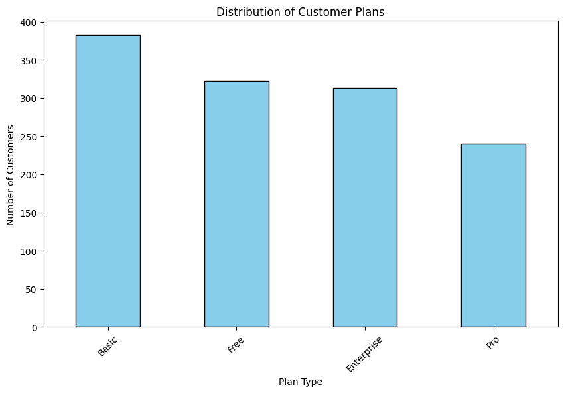
Exploratory Analysis
Univariate Analysis
Distribution of Customer Plans
This visualization shows the composition of our subscriber base across different tiers.
Observation: The Basic plan is our most popular tier, followed by Free and Enterprise. The Pro plan has the smallest number of subscribers.
Business Insight: The Basic plan holds the largest share, so retention strategies or pricing changes here will have the most significant impact on revenue stability.

Slide 5
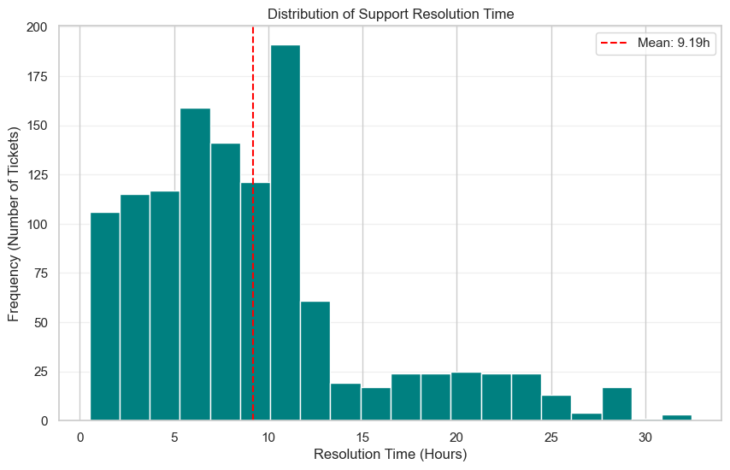
Exploratory Analysis
Univariate Analysis
Support Resolution Time
This histogram illustrates the distribution of time taken to resolve customer support tickets.
Observation: The average resolution time is 9.19 hours. While many tickets are resolved quickly, some take over 30 hours.
Business Insight: Long resolution times suggest a bottleneck in support operations. This provides evidence to investigate if delays drive rising churn rates.

Slide 6
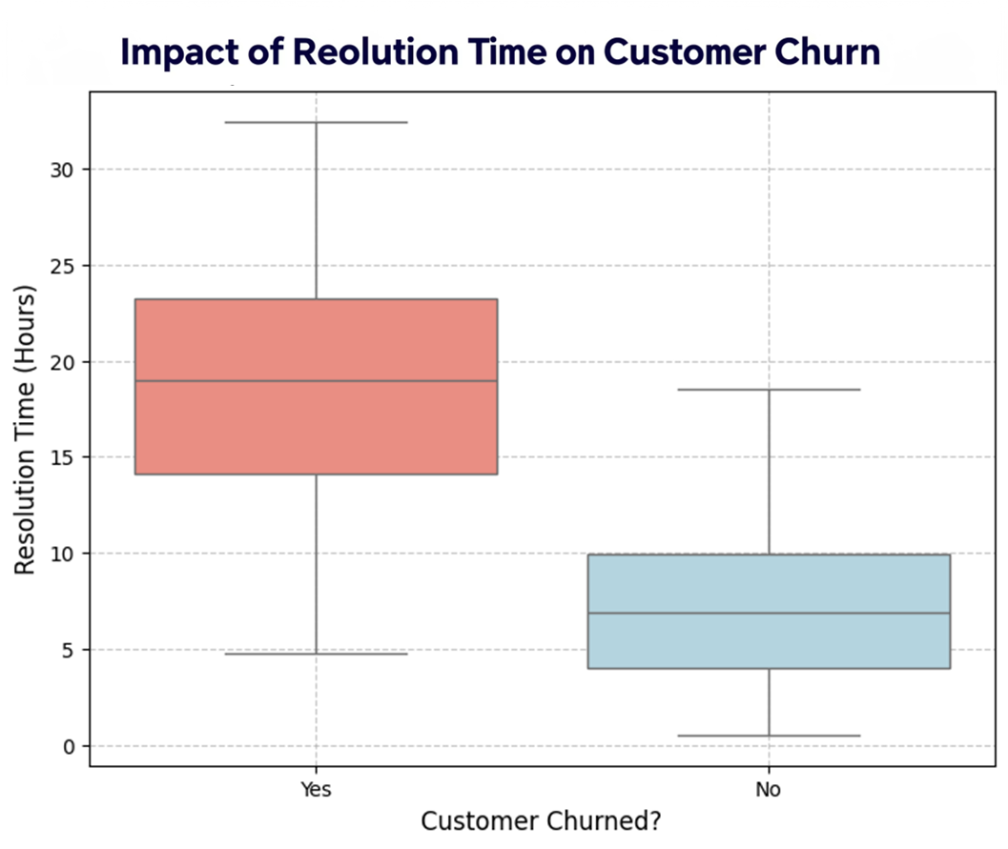
Exploratory Analysis
Multivariate Analysis
Impact of Resolution Time on Churn
This box plot compares resolution times across churned and retained customers.
Observation: Churned customers faced significantly higher median resolution times (approx. 15+ hours) compared to retained customers (under 10 hours).
Business Insight: Support latency is a primary driver of churn. Even a single excessively long wait time can lead to customer departure.

Slide 7
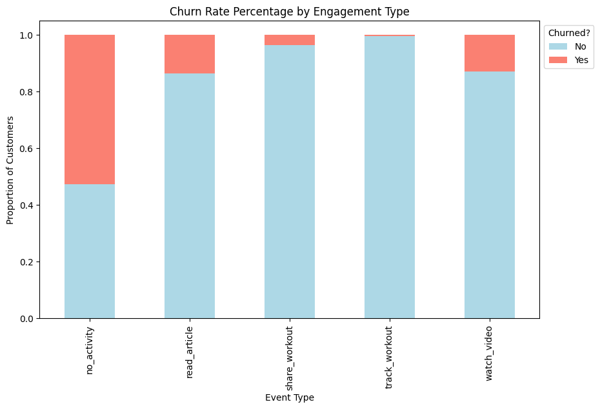
Exploratory Analysis
Multivariate Analysis
Churn Rate by Engagement Type
This stacked bar chart illustrates how user activity correlates with churn likelihood.
Observation: Users with 'no_activity' have the highest churn (>50%). Passive activities ('watch_video', 'read_article') have moderate churn (~13%). Active users ('track_workout') have negligible churn (0.4%).
Business Insight: Active engagement is the strongest retention tool. Dormant users pose a critical risk, and 'track_workout' is a key investment area for retention.

Slide 8
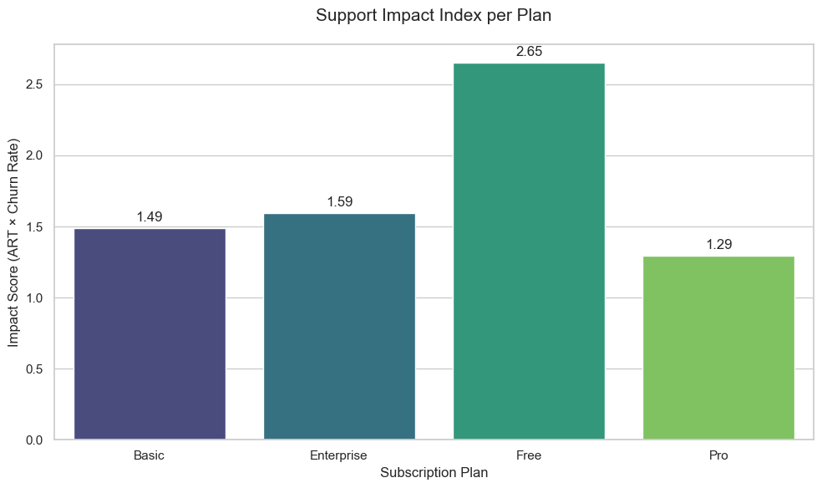
Metric Definition: Support Impact Index
To proactively monitor churn risk and support performance, we propose the Support Impact Index, combining Average Resolution Time and Churn Rate.
Insight: The Free Plan has the highest index (2.65), confirming it as the highest-risk segment. The Pro Plan is the most stable (1.29).

Slide 9







Monitoring the Metric
The Support Impact Index should be used as a leading indicator of customer dissatisfaction.
Weekly Monitoring
Risk Identification
Goal Setting
Track by plan type, channel, and topic to pinpoint emerging issues.
High index scores (e.g., Free plan) indicate disproportionate churn risk, prompting immediate investigation.
Set targets (e.g., Pro plan index below 1.5) to ensure performance remains acceptable.
Analysis Constraints: Identified factors are correlations, not direct causes. Assumes daily data integrity and excludes external market shifts or unrecorded offline behaviors.

Slide 10





Strategic Recommendations
Improve Support Efficiency
Invest in staff/workflow optimization to reduce resolution times, aiming for an index below 1.2 across all plans.
Focus on High-Impact Plans
Dedicate resources to Enterprise clients and investigate strategies for the Free tier (e.g., robust FAQs).
Monitor Key Metrics Weekly
Implement a weekly dashboard for the Support Impact Index and Average Resolution Time by Plan.
Enhance Product Engagement
Introduce initiatives to boost user activity within the Basic plan tier through new features or targeted communication.

